Slide 1
Exploratory Data Analysis-SampleSuperstore
File created on: 30-07-2020 19:21:58

Slide 2
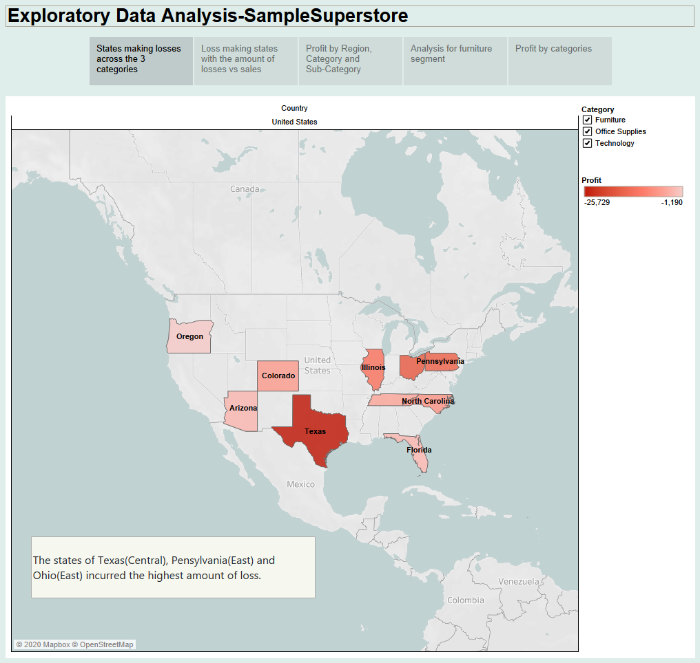

Slide 3
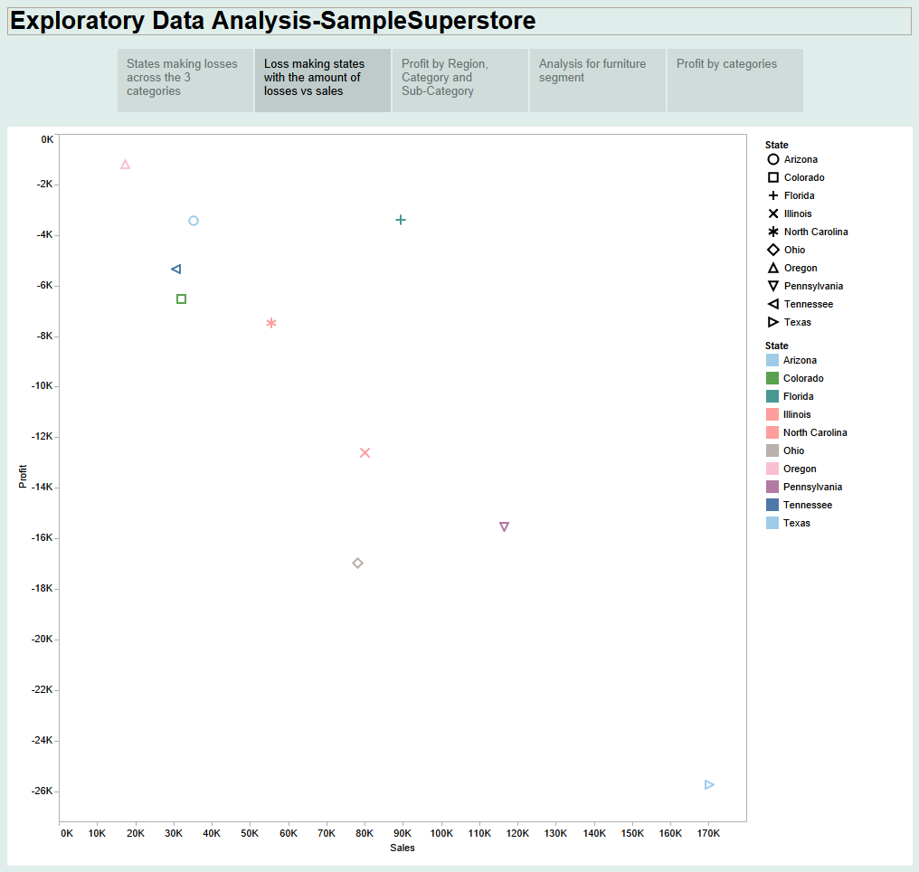

Slide 4
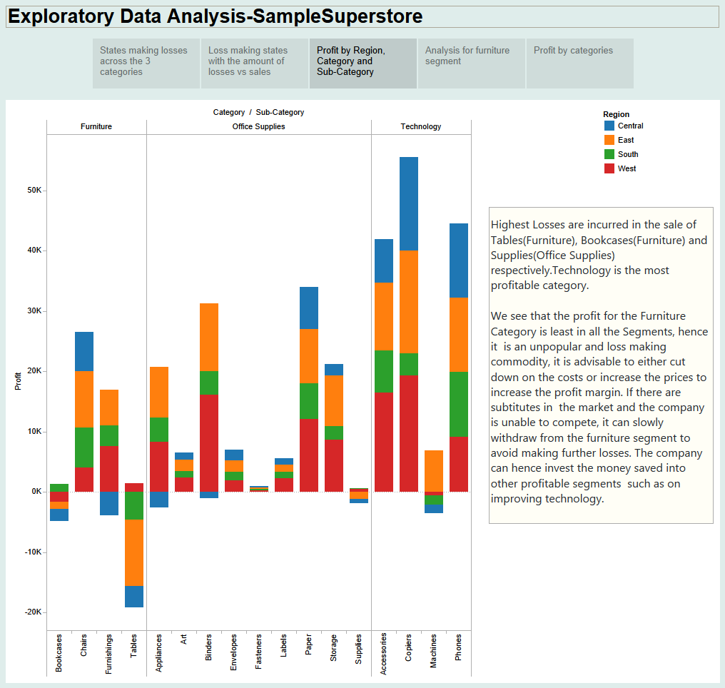

Slide 5
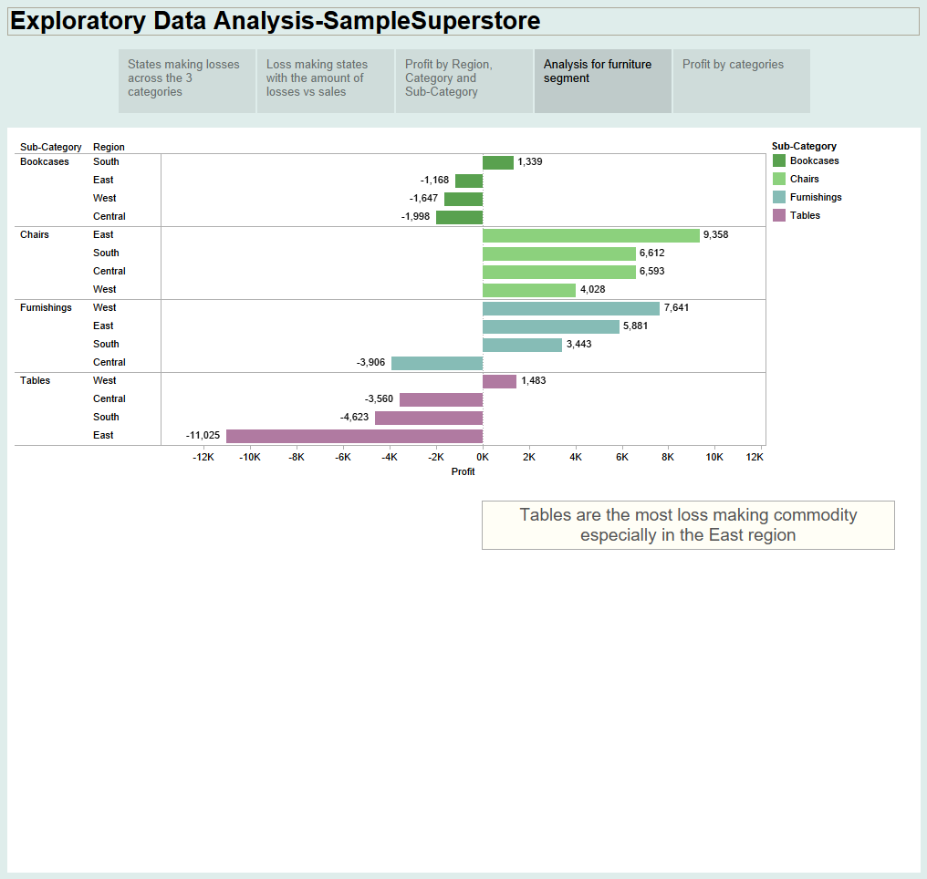

Slide 6
